Slide 1
Hacking With Hardware
AN - AKM - JB - CJL

Slide 2
Intercepting
IR and RF Signals

Slide 3
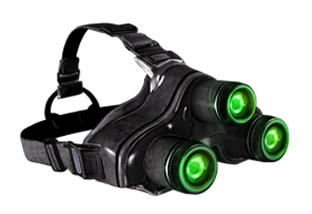
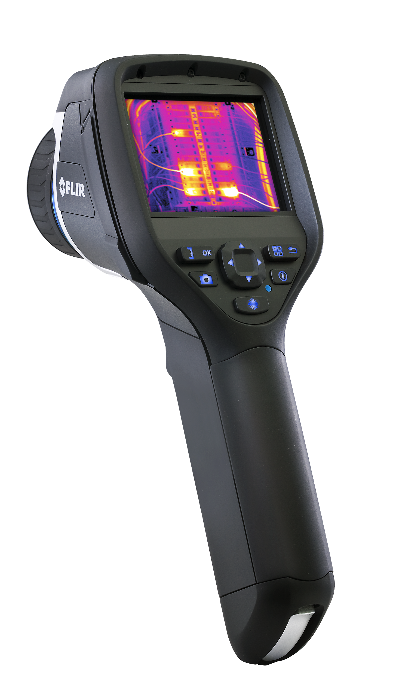
What is IR?
Infrared
Have a frequency of 430 THz (Terahertz) to 300 GHz (Gigahertz)
Wavelength of 700 nm (Nanometer) to 1 mm (Millimeter)
• Found in many different devices
Night Vision headgear, Thermo, Remotes, and etc

Slide 4
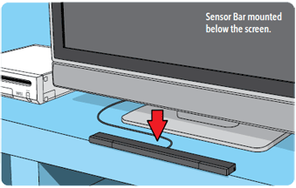
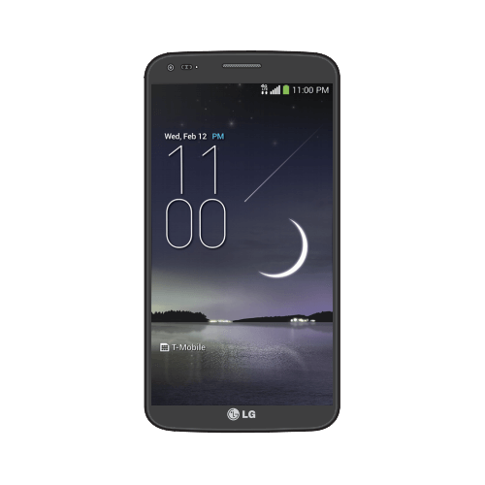
What use IR?
Commonly used in remote controls
TV, Air conditioning units, and Nintendo products
Now more and more smartphone are coming with IR sensors
LG and Samsung devices

Slide 5
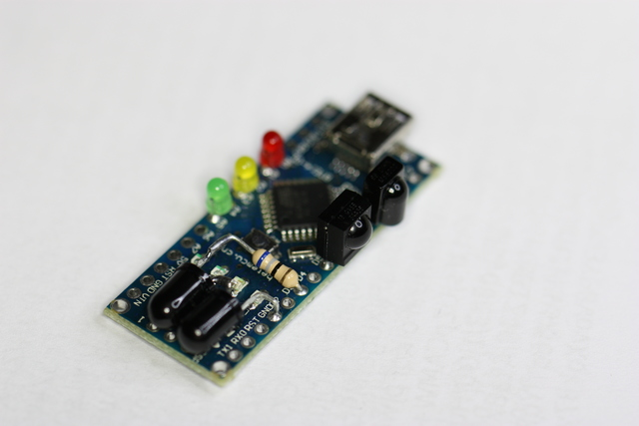
IrScrutinizer (Program)
Use for capturing and sending IR signals
Basically a program of the universal remote for everything that use IR
Using a CH340 board for receiving and sending the signals from program
The actual universal remote

Slide 6
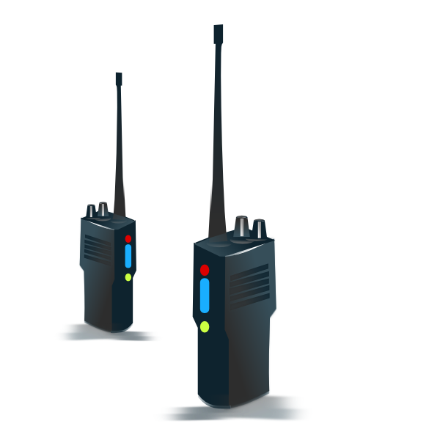
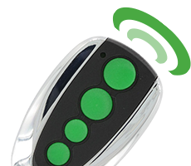
What is RF?
Radio Frequency
Use some sort of antenna to communicate to devices
Wavelength ranges from 3 KHz to 300 GHz
Used in many devices
Such as radio communication and control system

Slide 7
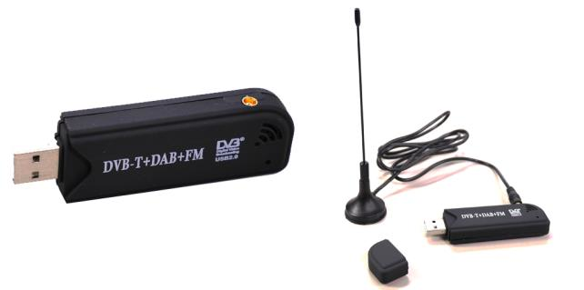
SDRSharp (Program)
Use to scan and receive radio signals
In conjunction with a SDR (Software Defined Radio)
Which is used to scan the area

Slide 8
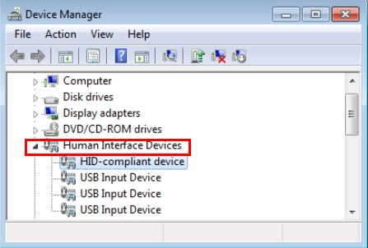
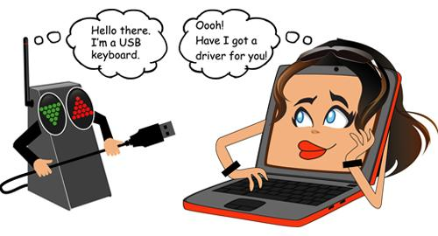
HID (Human Interface Device)
Mouse, Keyboards, all are considered HID.
Our HID emulates mouse and keyboard functionalities, making hardware based attacks possible.
Most Antivirus companies don’t consider hardware attacks as form of exploitation. What this enables is no hardware ID checks on what’s being plugged in your machine. So essentially, no A/V will detect this hardware.
This HID is compatible with Mac, Windows, and Linux/UNIX. It can be reprogrammed to accomplish any other type of OS (it’s very universal since each crafted payload is just keystrokes and mouse clicks).

Slide 9
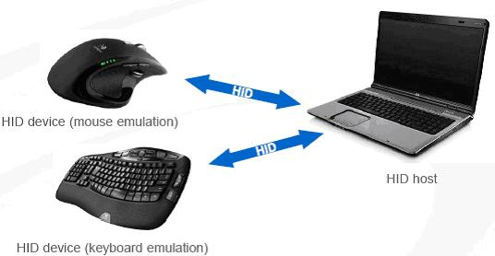

Slide 10
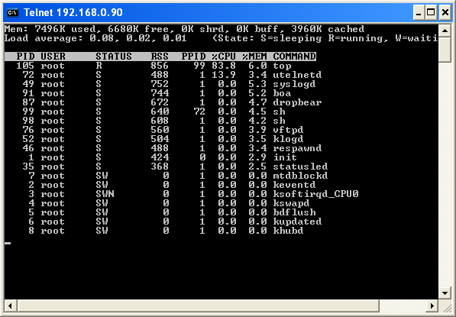
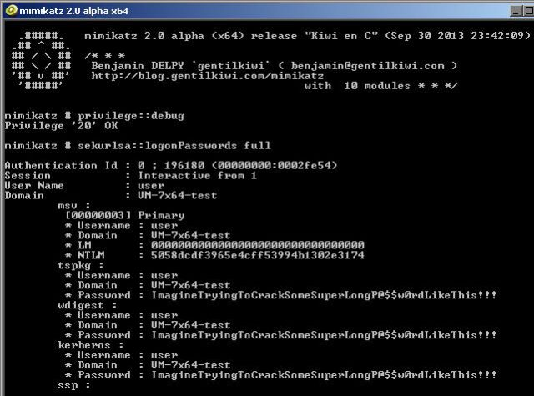
HID w/ Telnet ;-)
The idea here is to get the malicious HID to open a CLI and connect to the hardcoded Telnet server, essentially another Arduino board in close proximity.
Once connected, it can start to transmit data to the telnet server using binary, hex, and any other means possible. When all of this is happening, anyone else connected to the telnet server can see all data being transmitted, essentially creating a midpoint for data exfiltration.
You can get really creative with this device by making it launch elevated CLI and then going forth downloading binaries from the web like “mimikatz” to grab plain text passwords from memory! This includes pin numbers, web browser caches, anything and everything stored within a computer’s RAM.
And then you can use the telnet server to transmit all the information back to a middle man! Talk about hollywood :-)

Slide 11
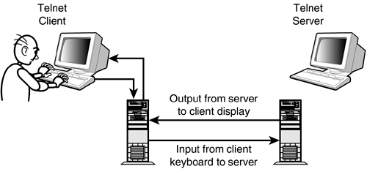

Slide 12
Onity Based Locks
Onity is a US firm that creates locks. One of their main consumers is hotels. The locks they create are based off RFID cards that interact with a handle, it’s what you see in almost every hotel you reserve.
The problem with these Onity locks is that they have a port on the lock itself designed for reprogramming the lock. This is a feature that allows hotel employees to change the locks to match other cards but it also gives them the option to keep a “master key” to those hotel doors. This is where things get fun :-)

Slide 14
Exploiting Onity Based Locks
The port required to connect to is a DC (coaxial) barrel connector, 5mm outer diameter, 2.1mm inner diameter. A “Master key” is stored onto the lock’s own board. Memory on the board itself can be read directly using the DC port. The “Open command” is also stored on the board. The board’s memory map is in Sitecode: 4 bytes at 0x114. We can program a board that inputs code in that manner. Almost any arduino can do this. This here is an example for how the “Open command” looks like once the data is exported.
So what does all this mean?
It means we can open all and every Onity lock.
It means we can access the hotel rooms.
It means no guest is safe!
For more info: http://demoseen.com/bhpaper.html

Slide 15
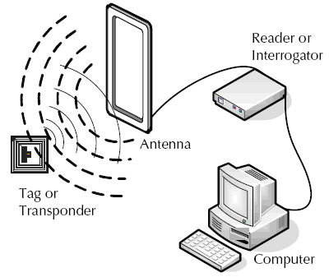
RFID (Radio-frequency Identification)
Uses electromagnetic fields that can attach to objects to track and identify tags
Antenna and radio memory chip
Tags are read by radio transmitters receivers that send a signal to the tag and read their response
Tags can be active - emits a signal that ticks
Tags can be passive - to be tripped it has to come in contact with a high power level
Tags can be read or read/write

Slide 16
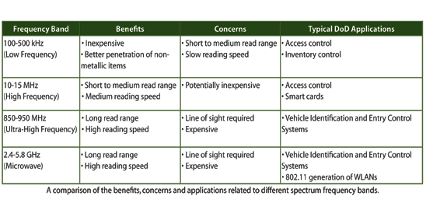
RFID Frequency Bands
Frequency of the band on the tag determines what radio waves the tag will be able to interact with

Slide 17
NFC (Near-field Communication)
NFC chips are RFID’s but way better
They have a read/write operation, card emulation, and P2P.

Slide 18
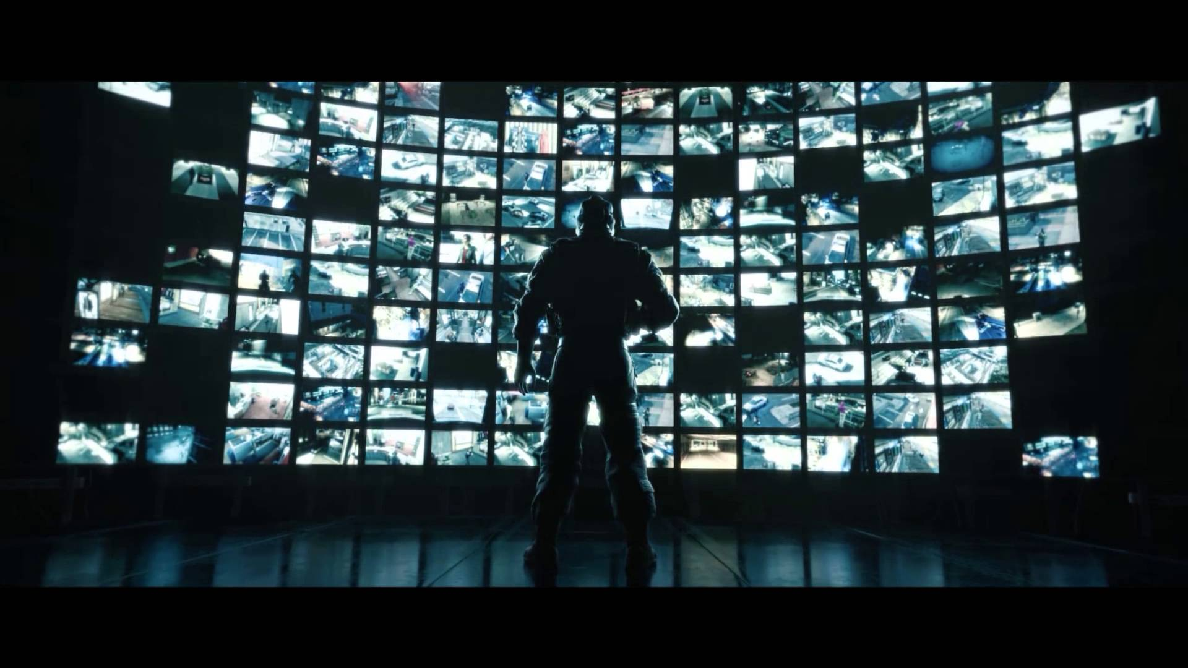
Deauthorizing a wifi signal
NodeMCU

Slide 19
The NodeMCU could
be used as a wifi “Jammer” or deautherizor. It is efficient and inexpensive wifi jamming solution. It operates on signals with a 2.4 GHz which is what most electronics use.
It is a network based chip that could be programmed in order to look for wifi signals and have to ability to tamper with them.

Slide 20
In order to deauthorize a signal it would have to have a signal of 2.4 GHz
Any devices that above that, it would not be able to “jam” or deauthorize signals. You could buy other chips that would be able to handle stronger signals.

Slide 21
Disclaimer
This deauthorizer and beacon is a form of tampering with a wifi signal doing this is considered illegal and should only be used as educational purposes only like so.
Do not use a NodeMCU for destructive purposes

Slide 22
EMP Device
Small handheld devices are capable of jamming and restarting small equipment. Also they are known to make small noises such as crackling on radios and making televisions to show stripes on the screen.
What is an EMP?
Electronic Magnetic Pulse
What can it do?
Jam and possibly destroy any electronics within the vicinity of its direction
What is its use?
Mainly military use, although small handhelds can be built for anyones uses.

Slide 23
What forms of energy can be transferred
Esentially all forms are usually present in an EMP but with all being present there is going to be something stronger than the other.
As a whole they all come together to destroy anything in its way that can conduct electricity.
Electric Field
Magnetic Field
Electromagnetic Radiation
Electrical Conduction

Slide 24
So how does it work?
Mine was built from a taser, reason being because it has a capacitor and can give out a specific charge already.Also the taser gives out a few thousand volts which helps. All I had to do would be to add the coil on the end of the taser and you have a successful mini handheld device.
There are other ways in order to create a handheld EMP out of simple supplies such as a camera’s motherboard. When that is done you would take out the PCB and add a switch to it in order to give the capacitor a certain charge. Then you would have to solder the coil to the board as well. From there you would have a handheld EMP

Slide 25
Handheld vs. NEMP
Again small handheld EMP’s can only do so much causing most things to jam. Although when held for too long on a certain device can damage properties to items. There is a major difference between handheld devices when comparing it to something nuclear.
Nuclear Electromagnetic Pulses is an effect that could happen over the span of a nuclear explosion. Instead of just radiation itself, NEMP has the effect to also leave electromagnetic radiation which could shut down everything within the radius of the explosion and completely destroy anything that uses power.
Pretty obvious between the differences but they still can DAMAGE items.

Slide 26
Disclaimer
To anyone who decides to make an EMP, please know the rules and laws in your county/country/state.
For the safety of most electronics be sure to never keep valuable or expensive items in front of the EMP to make sure that your valuables are safe
Be safe and responsible to anyone using an EMP
With Great Power Comes Great Responsibility

Slide 27
Harms of an EMP
Harms of the EMP can include permanently damaging your electronics (i.e. streaks on your LED screens) and possibly breaking.
No matter whether it is handheld and or nuclear just know that you will most likely destroy what you test it on.
It can also cause a spark of electricity which would cause harm to yourself and you never know how it could affect you.
Proof of what can be done is shown in the alarm clock that we brung in and as well as a robosapiens robot that could not be here for the IR demonstration.

